Slide 1
Chap 5: Neural Nets
BCS2313: Artificial Intelligence Techniques

Slide 2


Slide 3
History
1943-McCulloch & Pitts are generally recognised as the designers of the first neural network
1949-First learning rule
1969-Minsky & Papert - perceptron limitation - Death of ANN
1980’s - Re-emergence of ANN - multi-layer networks

Slide 4
The Biological Inspiration
The brain has been extensively studied by scientists.
Very complexity and only small portion knows by scientists.
Even the behavior of an individual neuron is extremely complex

Slide 5
Features of Brain
Ten billion neurons
Neuron switching time >10-3secs
Face Recognition ~0.1secs
On average, each neuron has several thousand connections
Hundreds of operations per second
High degree of parallel computation
Distributed representations
Die off frequently (never replaced)
Compensated for problems by massive parallelism

Slide 6
Brain vs. Machine
The Brain
Pattern Recognition
Association
Complexity
Noise Tolerance
The Machine
Calculation
Precision
Logic

Slide 7
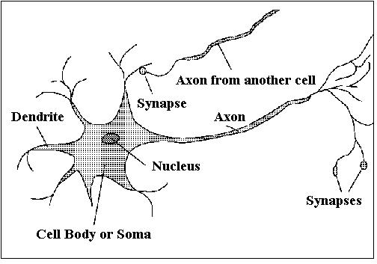
Biological Neurons

Slide 8
Biological Neurons
A neuron only fires if its input signal exceeds a certain amount (the threshold) in a short time period.
Synapses vary in strength
Good connections allowing a large signal
Slight connections allow only a weak signal.
Synapses can be either excitatory or inhibitory.

Slide 9
Biological Neurons
A neuron has a cell body, a branching input structure (the dendrite) and a branching output structure (the axon)
Axons connect to dendrites via synapses.
Electro-chemical signals are propagated from the dendritic input, through the cell body, and down the axon to other neurons

Slide 10
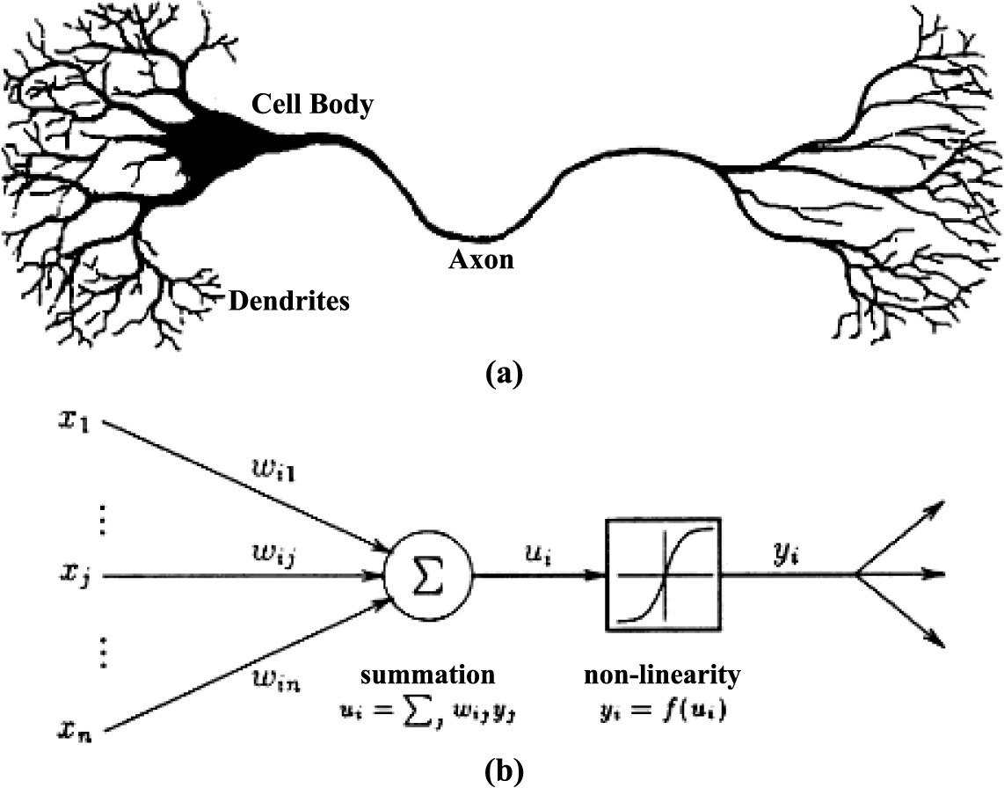
Biological vs. Artificial Neurons

Slide 11
Artificial Neural Networks (ANN)
Approximation of biological neural nets by ANN’s
No direct model of accumulator function over time
Synaptic strength
Approximate with connection weights (real numbers)
Spiking of output
Approximate with non-linear activation functions
Neural units
Represent activation values (numbers)
Represent inputs, and outputs (numbers)

Slide 12
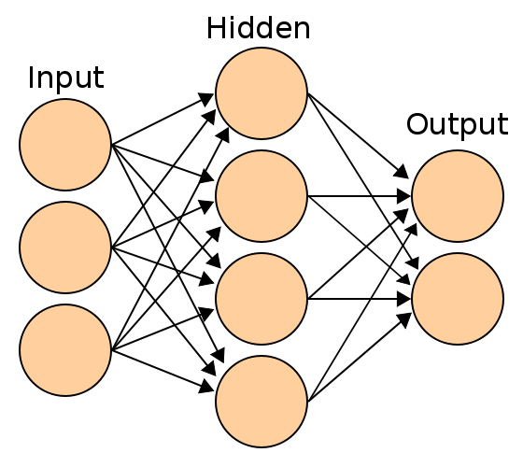
Basic Structure of Neural Network

Slide 13
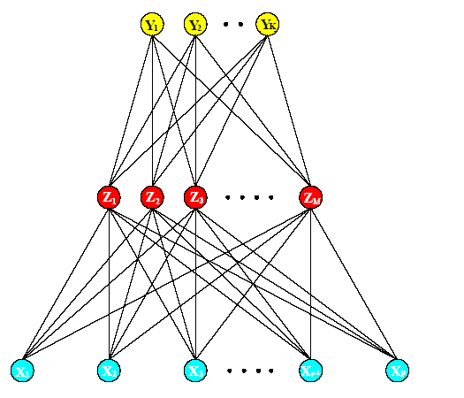
Basic Structure of Neural Network
Output layer
Hidden layer
Input layer

Slide 14
Basic Structure of Neural Network
Input units/nodes
represents the input as a fixed-length vector of numbers (user defined)
Hidden units/nodes
calculate threshold weighted sums of the inputs
represent intermediate calculations that the network learns
Output units/nodes
represent the output as a fixed length vector of numbers

Slide 15
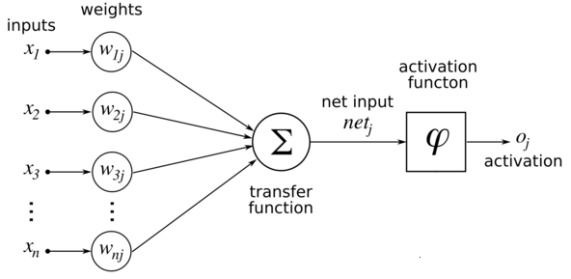
Basic Structure of Neural Network

Slide 16
Graphical Notation & Terms
Circles
Are neural units
Metaphor for nerve cell body
Arrows
Represent synaptic connections from one unit to another
These are called weights and represented with a scalar numeric value (e.g., a real number)
Another layer of neural units
One layer of neural units

Slide 17
Units & Weight
Units (notes)
Sometimes notated with unit numbers
Weights
Sometimes give by symbols
Sometimes given by numbers
Always represent numbers
May be integer or real valued
1
W_{1,1}
2
W_{1,2}
1
3
W_{1,3}
Unit number
Unit numbers
W_{1,4}
4
1
0.3
2
-0.1
1
2.1
3
-1.1
4

Slide 18
Computing with Neural Units
Inputs are presented to input units
How do we generate outputs?
One idea
Summed Weighted Inputs
Input: (3, 1, 0, -2)
Processing:
3(0.3) + 1(-0.1) + 0(2.1) + -1.1(-2)
= 0.9 + (-0.1) + 2.2
Output: 3
1
0.3
2
-0.1
1
2.1
3
-1.1
4

Slide 19
Activation Function
Usually, don’t just use weighted sum directly
Apply some function to the weighted sum before it is used (e.g., as output)
Call this the activation function
Step function, Sigmoid function, Linear Function, Gaussian Function

Slide 20
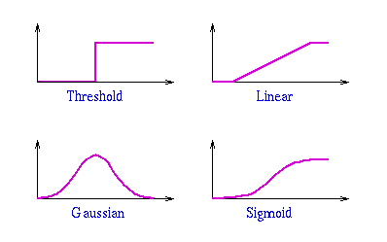
Basic Structure of Neural Network

Slide 21
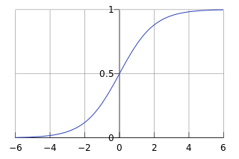
Sigmoid Activation Function
The math of some neural nets requires that the activation function be continuously differentiable.
A sigmoid function is a mathematical function having an "S" shape (sigmoid curve).

Slide 22
Sigmoid Example
Input: (3, 1, 0, -2)
0.3
-0.1
2.1
-1.1
Input: (2, 10, 0, 3) – What is the output?

Slide 23
Basic Structure of Neural Network
A two weight layer, feedforward network
Two inputs, one output, one ‘hidden’ unit
Input: (3, 1)
0.5
0.75
-0.5
What is the output?

Slide 24
Advantages/Disadvantages of NN
Advantages
Suitable for large dataset
Ability to generalize pattern/learn form large set of data
Eager learning
Disadvantages
Black-box learning – no explanation facilities
Not incremental learning
Longer time to generate pattern/learning (for large set of data)

Slide 25
Figure 1 shows a fully connected feed-forward neural networks. Assume that the training data ‘Stock Price’ range is from RM20 to RM95 and a neural networks modeling is applied to predict the ‘Stock Price’. The current value of ‘Stock Price’ is RM50, RM65, RM92, RM31 and RM82. Using the weights given in Table 2 calculate the predicted value of the future ‘Stock Price’.
Initial Weight Values
W_{AF} | W_{BF} | W_{CF} | W_{DF} | W_{EF}
0.45 | -0.39 | 0.12 | 0.7 | -0.88
Table 2.
Figure 1.

Slide 26
Input: x = (real value – min value) / Range
Sigmoid function
Prediction value = Range * output + min value

